Slide 1

R프로그램, 파이썬 유량 예측 결과
2006-2021 water.or.kr 자료

Slide 2
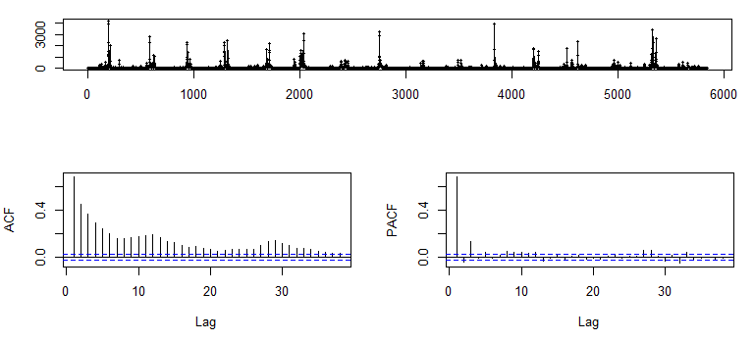
소양강댐유입량 tsdisplay

Slide 3
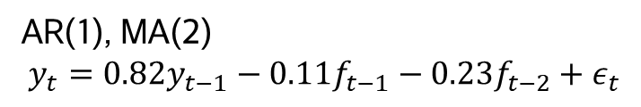
auto.arima
AR(1), MA(2)
$$y_{t}=0.82y_{t−1}−0.11f_{t−1}−0.23f_{t−2}+ε_{t}$$
ARIMA(1,0,2) with non-zero mean
Coefficients:
ar1 ma1 ma2 mean
0.8290 -0.1136 -0.2321 65.6673
s.e. 0.0165 0.0227 0.0203 7.7667
sigma^2 = 24119: log likelihood = -37775.8
AIC=75561.6 AICc=75561.61 BIC=75594.97
Training set error measures:
ME RMSE MAE MPE MAPE MASE ACF1
Training set -0.006085326 155.2493 37.4511 -Inf Inf 1.043228 0.001020012
예측모형 적합도
ME : -0.0 RMSE : 155.2
MAE : 37.45 MAPE : -inf

Slide 4
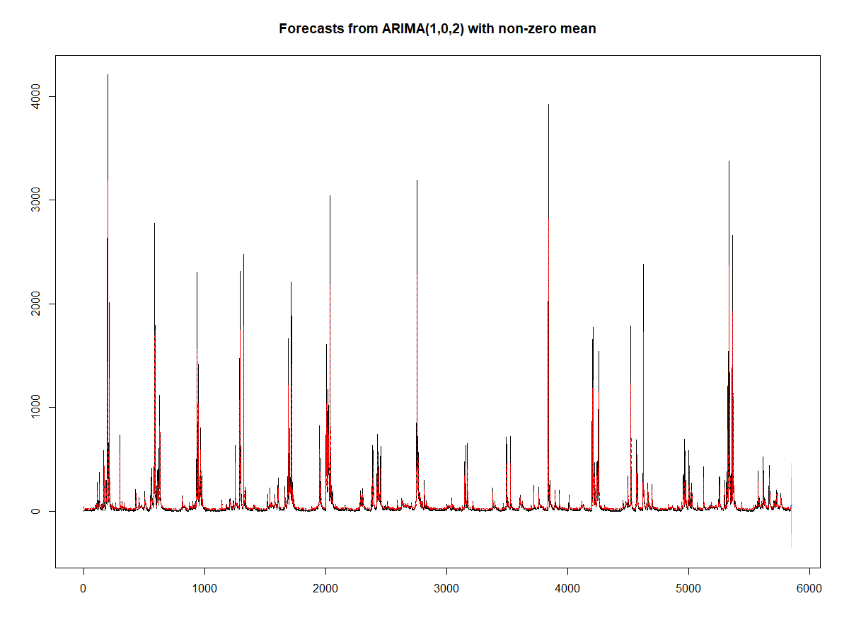
forecast plot

Slide 5
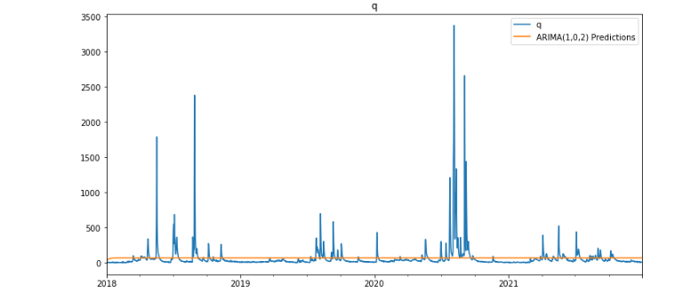
train = 2006-2017 (75%)
test = 2018-2021 (25%)
ARIMA(1,0,2) MSE Error: 36327.58598
ARIMA(1,0,2) RMSE Error: 190.5979695

Slide 6
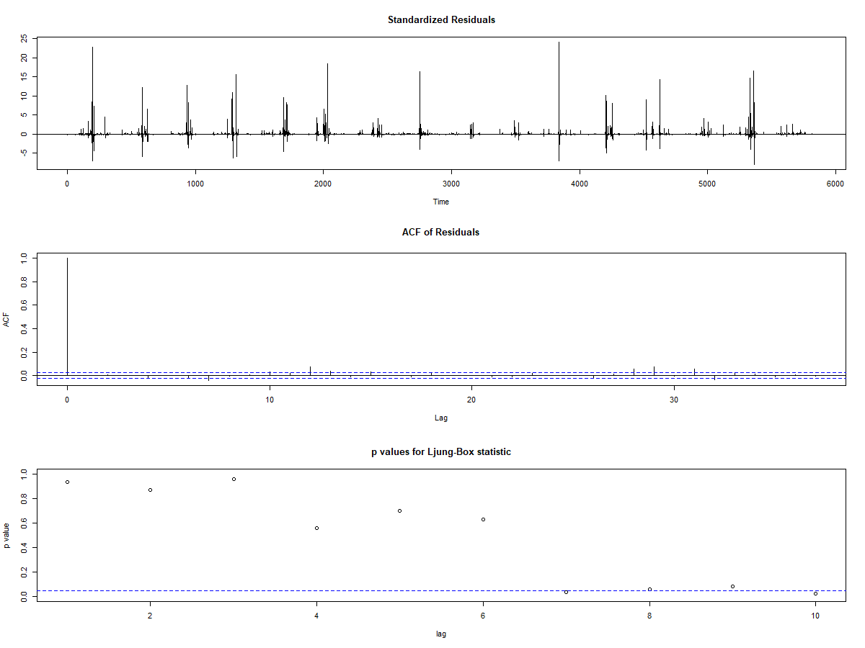
tsdiag
Residual 분석 결과
정상시계열로 판단됨

Slide 7
(95% 신뢰구간)
Point Forecast
2022-01-01 22.39718 (-281.9900 ~ 326.7844)
2022-01-02 33.29564 (-340.9707 ~ 407.5620)
2022-01-03 38.83046 (-351.2351 ~ 428.8960)
2022-01-04 43.41894 (-357.1440 ~ 443.9819)
2022-01-05 47.22290 (-360.3979 ~ 454.8437)
2022-01-06 50.37647 (-362.0250 ~ 462.7780)
2022-01-07 52.99086 (-362.6644 ~ 468.6462)
2022-01-08 55.15824 (-362.7186 ~ 473.0351)
2022-01-09 56.95505 (-362.4419 ~ 476.3520)
2022-01-10 58.44465 (-361.9937 ~ 478.8830)

Slide 8
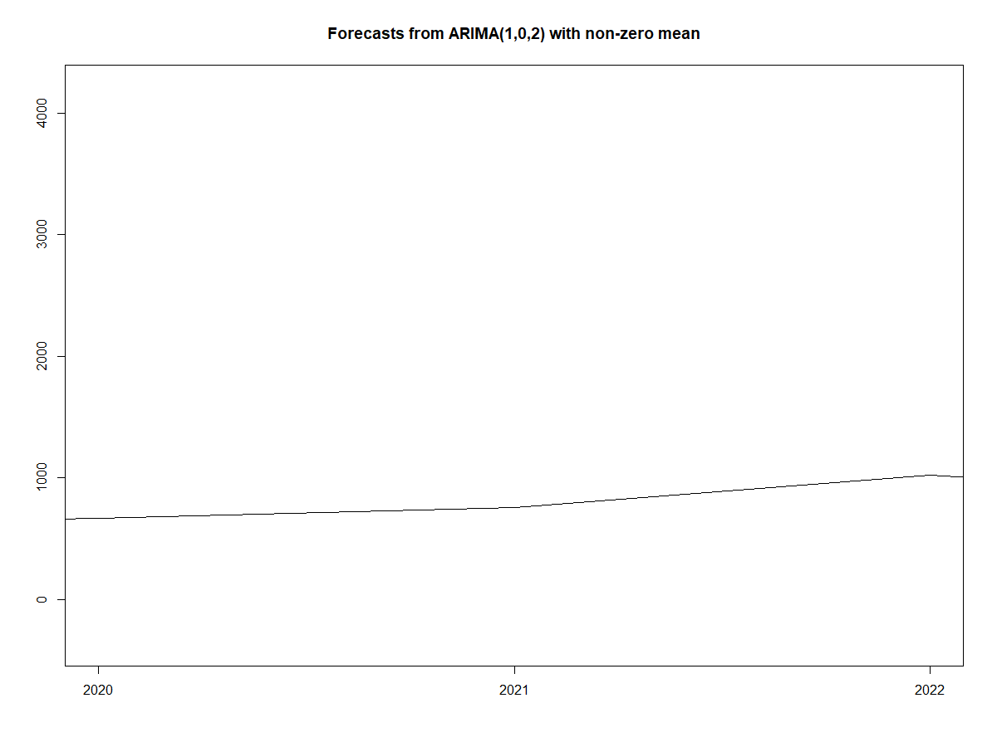
2020-2022년도 예측

Slide 9
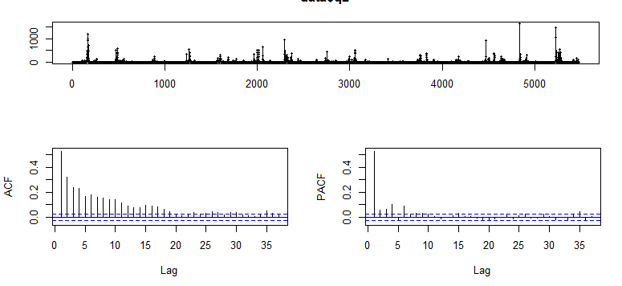
임하댐유입량 tsdisplay

Slide 10
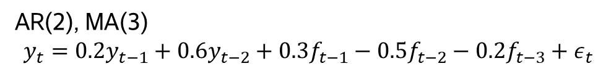
auto.arima
AR(2), MA(3)
$$y_{t}=0.2y_{t−1}+0.6y_{t−2}+0.3f_{t−1}−0.5f_{t−2}−0.2f_{t−3}+ε_{t}$$
ARIMA(2,0,3) with non-zero mean
Coefficients:
ar1 ar2 ma1 ma2 ma3 mean
0.1987 0.6279 0.2882 -0.4812 -0.2353 16.5396
s.e. 0.0622 0.0504 0.0623 0.0336 0.0182 2.3977
sigma^2 = 2907: log likelihood = -29618.86
AIC=59251.72 AICc=59251.74 BIC=59297.98
Training set error measures:
ME RMSE MAE MPE MAPE MASE ACF1
Training set -0.003383558 53.88799 13.87626 -Inf Inf 1.204114 6.48917e-05
예측모형 적합도
ME : -0.0 RMSE : 53.9
MAE : 13.88 MAPE : -inf

Slide 11
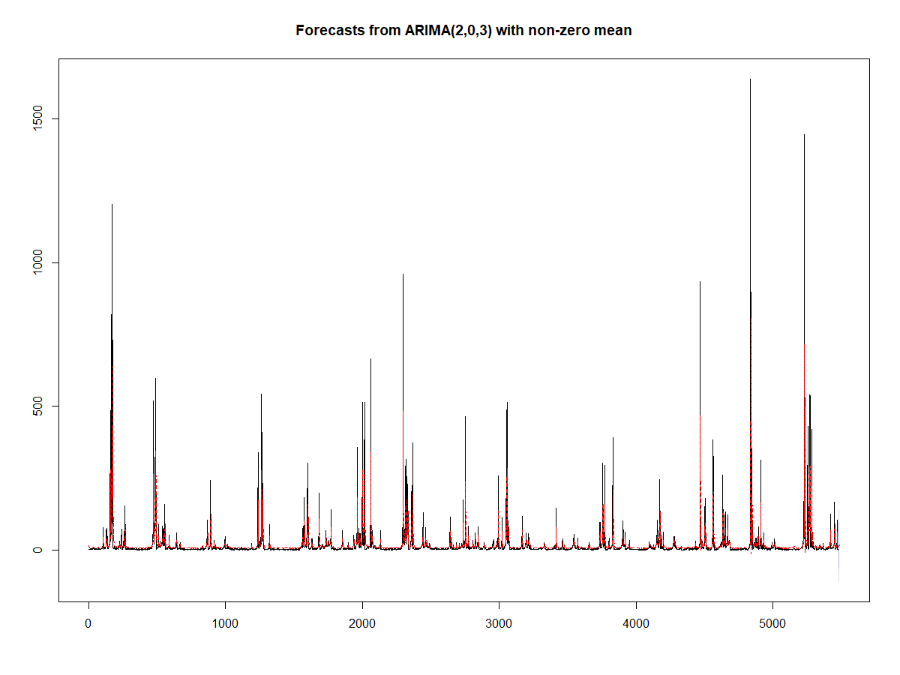
forecast plot

Slide 12
(95% 신뢰구간)
Point Forecast
2022-01-01 8.799009 (-96.8774 ~ 114.4754)
2022-01-02 11.099740 (-106.4376 ~ 128.6371)
2022-01-03 12.628475 (-107.6918 ~ 132.9488)
2022-01-04 12.346772 (-108.6266 ~ 133.3201)
2022-01-05 13.250635 (-109.1517 ~ 135.6530)
2022-01-06 13.253395 (-109.6962 ~ 136.2030)
2022-01-07 13.821453 (-109.9240 ~ 137.5669)
2022-01-08 13.936081 (-110.2177 ~ 138.0898)
2022-01-09 14.315529 (-110.3068 ~ 138.9379)
2022-01-10 14.462912 (-110.4464 ~ 139.3723)

Slide 13
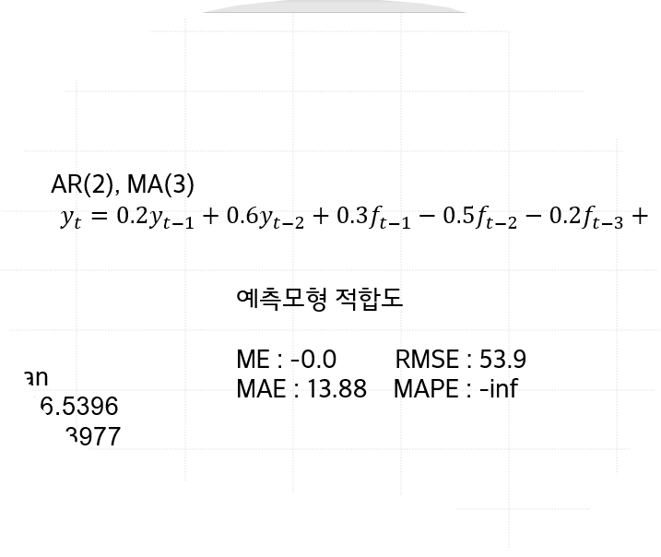
임하 ARMA(1,1)
Residuals:
Min 1Q Median 3Q Max
-688.219 -6.832 -5.512 -3.002 1549.460
Coefficient(s):
Estimate Std. Error t value Pr(>|t|)
ar1 0.64034 0.02275 28.150 < 2e-16 ***
ma1 -0.15716 0.03086 -5.093 3.53e-07 ***
intercept 5.94469 0.72570 8.192 2.22e-16 ***
Signif. codes: 0 ‘***’ 0.001 ‘**’ 0.01 ‘*’ 0.05 ‘.’ 0.1 ‘ ’ 1
Fit:
sigma^2 estimated as 2972, Conditional Sum-of-Squares = 16279063, AIC = 59370.72

Slide 14
파이썬을 이용한 ARIMA
Dep. Variable: | y | No. Observations: | 5844
Model: | SARIMAX(1, 0, 2) | Log Likelihood | -37775.806
Date: | Sat, 30 Jul 2022 | AIC | 75561.611
Time: | 21:40:14 | BIC | 75594.977
Sample: | 0 | HQIC | 75573.214
 | - 5844
Covariance Type: | opg
 | coef | std err | z | P>|z| | [0.025 | 0.975]
intercept | 11.2228 | 3.275 | 3.426 | 0.001 | 4.803 | 17.642
ar.L1 | 0.8289 | 0.009 | 93.958 | 0.000 | 0.812 | 0.846
ma.L1 | -0.1134 | 0.009 | -12.273 | 0.000 | -0.131 | -0.095
ma.L2 | -0.2319 | 0.008 | -27.414 | 0.000 | -0.248 | -0.215
sigma2 | 2.415e+04 | 82.302 | 293.459 | 0.000 | 2.4e+04 | 2.43e+04

Slide 15
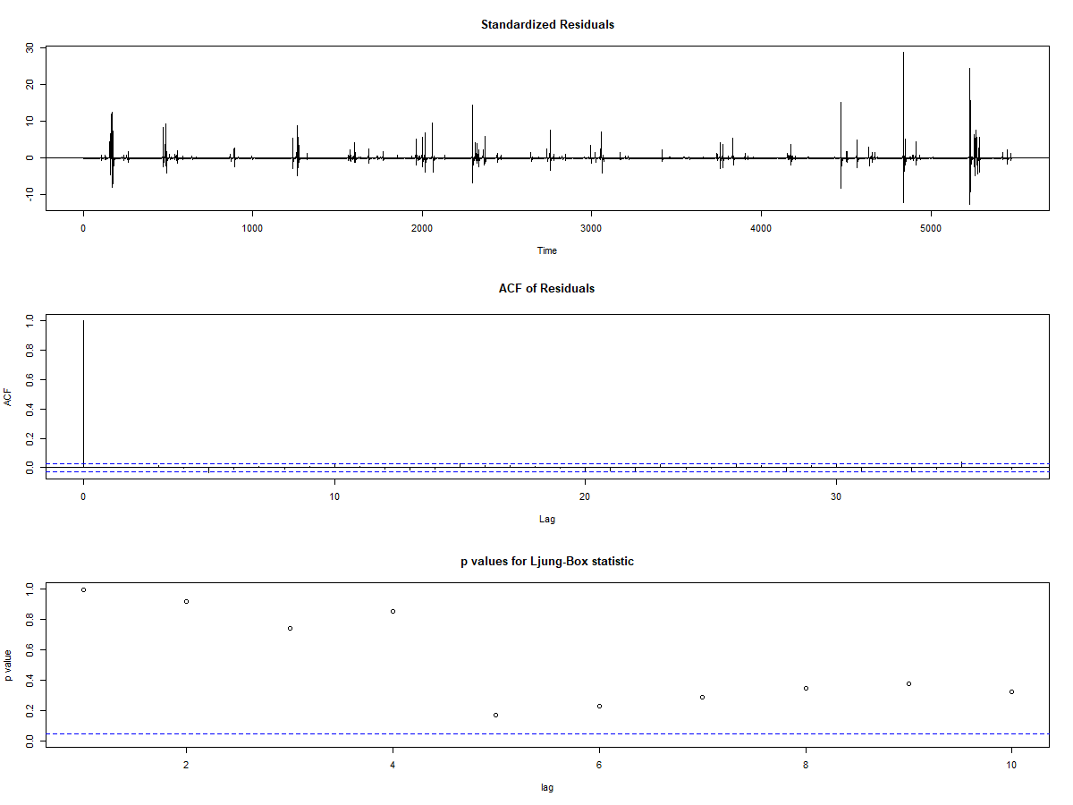
tsdiag
Residual 분석 결과
정상시계열로 판단됨

Slide 16
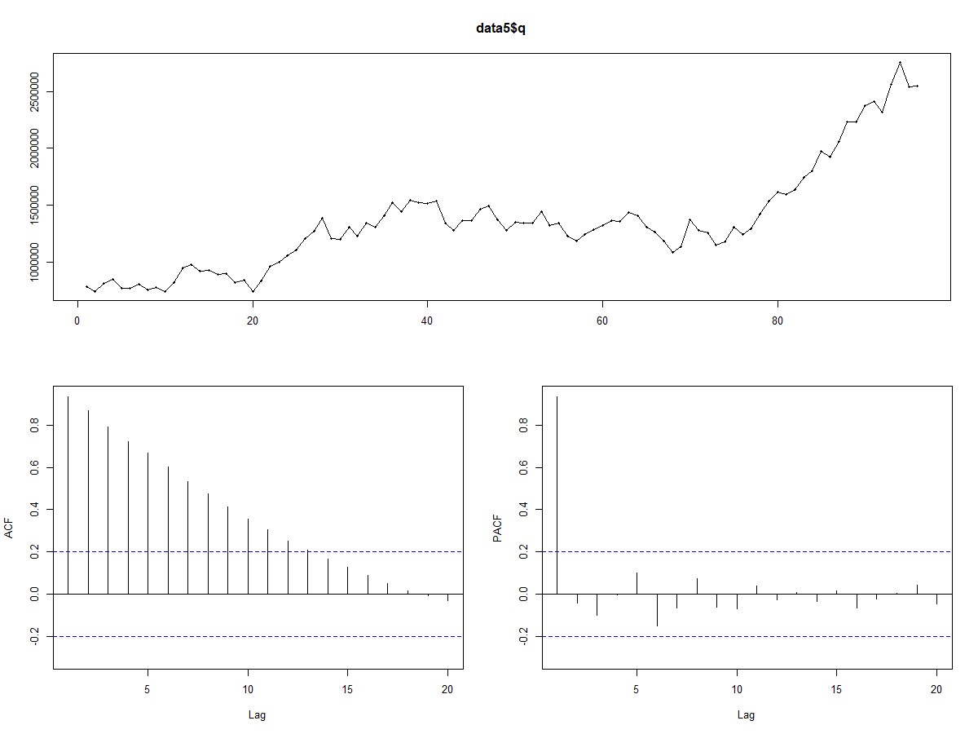
삼성전자 달단위
예측모형 적합도
ME : 85.4 RMSE : 86318.6
MAE : 69587.5 MAPE : -0.5
Series: data5.ts
ARIMA(2,1,1) with drift
Coefficients:
ar1 ar2 ma1 drift
-0.8503 -0.1708 0.8875 18666.214
s.e. 0.1480 0.1118 0.1239 8328.024
sigma^2 = 7.86e+09: log likelihood = -1215.26
AIC=2440.52 AICc=2441.19 BIC=2453.29
Training set error measures:
ME RMSE MAE MPE MAPE MASE ACF1
Training set 85.42938 86318.65 69587.5 -0.5113194 5.408572 0.2376738 0.004204942
KPSS Test for Level Stationarity
data: data5.ts
KPSS Level = 1.6231, Truncation lag parameter = 3, p-value = 0.01
-> 정상시계열

Slide 17
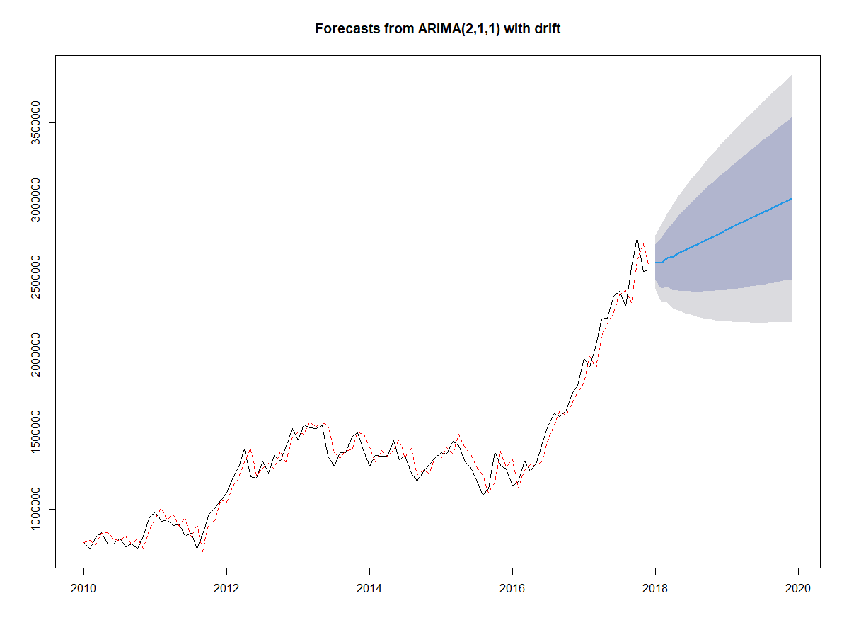
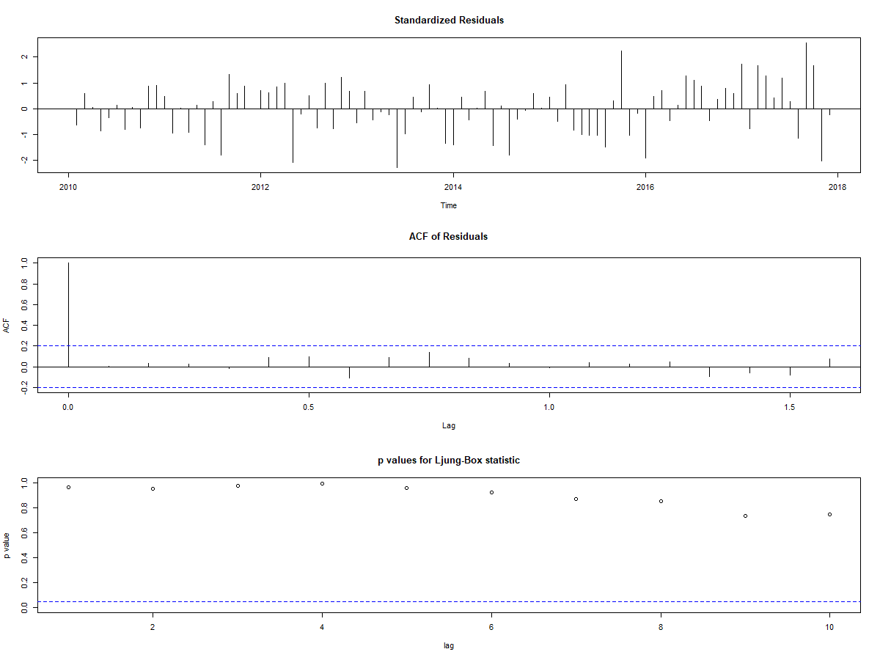
tsdiag

Slide 18
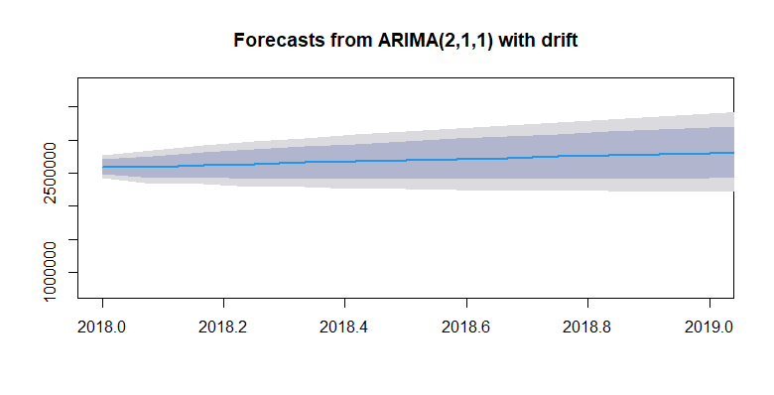
Point Forecast Lo 80 Hi 80 Lo 95 Hi 95
Jan 2018 2597004 2483384 2710624 2423237 2770771
Feb 2018 2591695 2427999 2755390 2341344 2842045
Mar 2018 2625567 2436378 2814756 2336227 2914907
Apr 2018 2635397 2414681 2856113 2297841 2972953
May 2018 2658980 2416005 2901955 2287382 3030578
Jun 2018 2674974 2408811 2941137 2267913 3082036
Jul 2018 2695073 2409052 2981094 2257642 3132504
Aug 2018 2712978 2407647 3018308 2246015 3179940
Sep 2018 2732047 2408935 3055158 2237890 3226203
Oct 2018 2750500 2410346 3090655 2230279 3270722
Nov 2018 2769279 2412992 3125566 2224385 3314173
Dec 2018 2787886 2416117 3159655 2219315 3356457
Jan 2019 2806583 2419977 3193189 2215320 3397847
Feb 2019 2825233 2424325 3226141 2212098 3438369
Mar 2019 2843908 2429198 3258618 2209664 3478152
Apr 2019 2862570 2434499 3290640 2207892 3517247
May 2019 2881238 2440213 3322263 2206749 3555727
Jun 2019 2899903 2446293 3353513 2206166 3593640
Jul 2019 2918570 2452715 3384425 2206106 3631034
Aug 2019 2937236 2459449 3415023 2206524 3667948
Sep 2019 2955902 2466475 3445330 2207388 3704417
Oct 2019 2974568 2473771 3475366 2208665 3740472
Nov 2019 2993235 2481319 3505150 2210328 3776141
Dec 2019 3011901 2489104 3534697 2212352 3811449

Slide 19
VARMA(p,q)
Dep. Variable: | ['temp', 'q'] | No. Observations: | 5476
Model: | VARMA(1,2) | Log Likelihood | -49136.118
 | + intercept | AIC | 98306.235
Date: | Mon, 01 Aug 2022 | BIC | 98418.573
Time: | 13:49:19 | HQIC | 98345.427

